Slide 1
Bina Roy
Partners In Development(BRPID)
Prepared by: Norma Pike

Slide 2
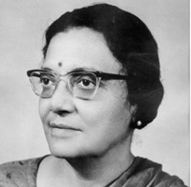
Who is bina Roy?
Notes:
The first Asian (India) President of IFUW (1971-1974);
She believed in supportive links among affiliates and strong international solidarity;
Encouraged the creation and implementation of Projects;
The BRPID projects are named in her memory.

Slide 3
Funding
Notes:
BRPID projects are made possible by:
Donations from GWI members and supporters worldwide;
Donations from the Virginia Gildersleeve International Fund (VGIG).
-----------------------------------------------------------------------------------------------------
The VGIG is a public foundation based in the US that supports women-led groups globally;
It’s aim is to implement local projects whose objective is to help improve the lives of women and girls by advancing women's rights and social justice;
Founded in 1969, it has funded 515 projects in 93 countries.
-----------------------------------------------------------------------------------------------------
BRPID Projects are awarded to GWI national federations and associations from developing countries on a competitive bases.

Slide 4
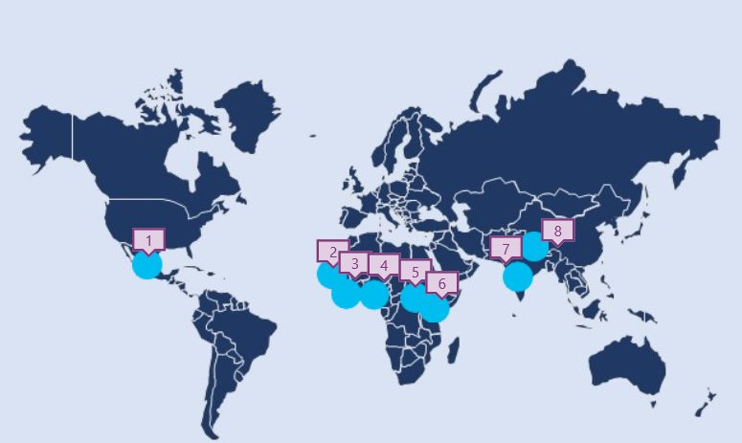
Location of Projects
Notes:
Mexico
Sierra Leone
Ghana
Nigeria
Uganda
Kenya
India
Nepal
In total, 8 projects: 5 in Africa, 1 in Mexico, 1 in India and 1 in Nepal.

Slide 5
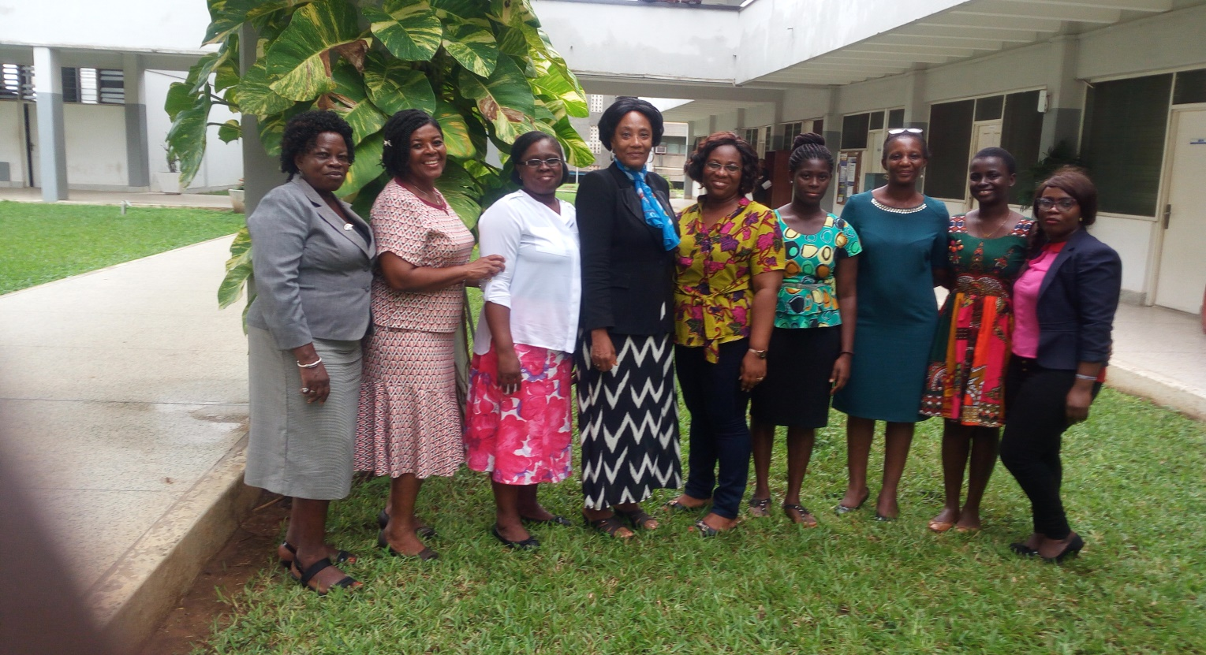
2016 Projects
Ghana: Harnessing Girls’ Potential in Education
Notes:
Administered by: the Ghana Association of University Women (GAUW)
Target Group: 60 school girls
Aim: To empower the target group with critical knowledge and skills to overcome barriers and complete their education successfully.
Objectives
To gain an understanding of the concept and theory of gender;
To be exposed to gender roles and impact;
To be empowered to evaluate decisions which affect their lives and to enable informed choices;
Mentorship.

Slide 6
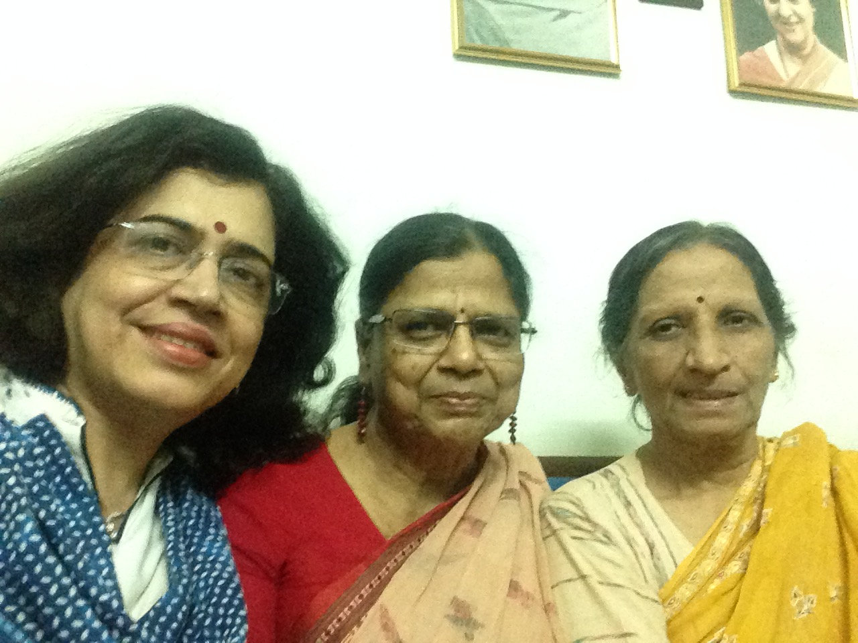
2016 Projects
India: Women’s Economic Empowerment through Education and Income-Generation Projects
Notes:
Administered by: Indian Federation of University Women’s Association (IFUWA)
Target Group: Low income girls and women
AIM: To increase their socioeconomic development.
Objectives
To impart income generating skills to girls and women;
To increase the income of project participants;
To impart skills in personality development, leadership and to achieve self-reliance.

Slide 7
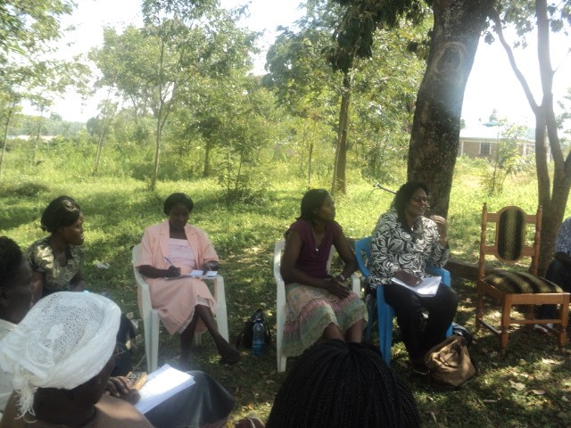
2016 Projects
Kenya: Capacity Building through Livelihoods Skills among Rural Women in Siaya County
Notes:
Administered by: Kenya Association of University Women (KAUW)
Target Group: 30 rural, female household heads.
Aim: To address gender inequality and to reduce severe poverty experienced among the target group in line with Kenya Vision 2030.
Objectives
To provide livelihood skills training;
To reduce poverty;
To contribute to women’s SE development and access to education for girls within those households;
To open up opportunities for women’s active participation in social, economic and political decision making processes in their communities.

Slide 8
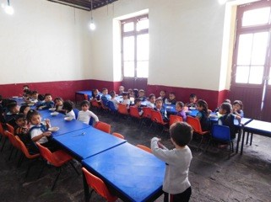
2016 projects
Mexico: Talks and Presentations on Oral Health and Self-Care Focused to Low Income Groups
Notes:
Administered by: Federación Mexicana de Universitarias, A.C. (FEMU).
Target Group: primarily low income groups.
Aim: To reduce the percentage of tooth decay, oral infections and diseases by teaching oral hygiene and preventive measures to the target group.
Objectives:
To teach oral hygiene;
To record individual cases;
To follow up and verify improvements;
To refer to public health institutions, when necessary.

Slide 9
2016 projects
Nepal: Economic Empowerment of Disadvantaged Women in Rural Households
Notes:
Administered by: Nepal Association of University Women(NAUW).
Target Group: 40 disadvantaged, illiterate, rural women.
AIM (two-fold): To provide the target group with basic literacy through non-formal education classes to enhance capability through skill training for initiating home based cottage industries.
Process:
To supports the women in accessing the market for their products;
To help increase knowledge of basic finance and marketing;
To improve their socio-economic status.

Slide 10
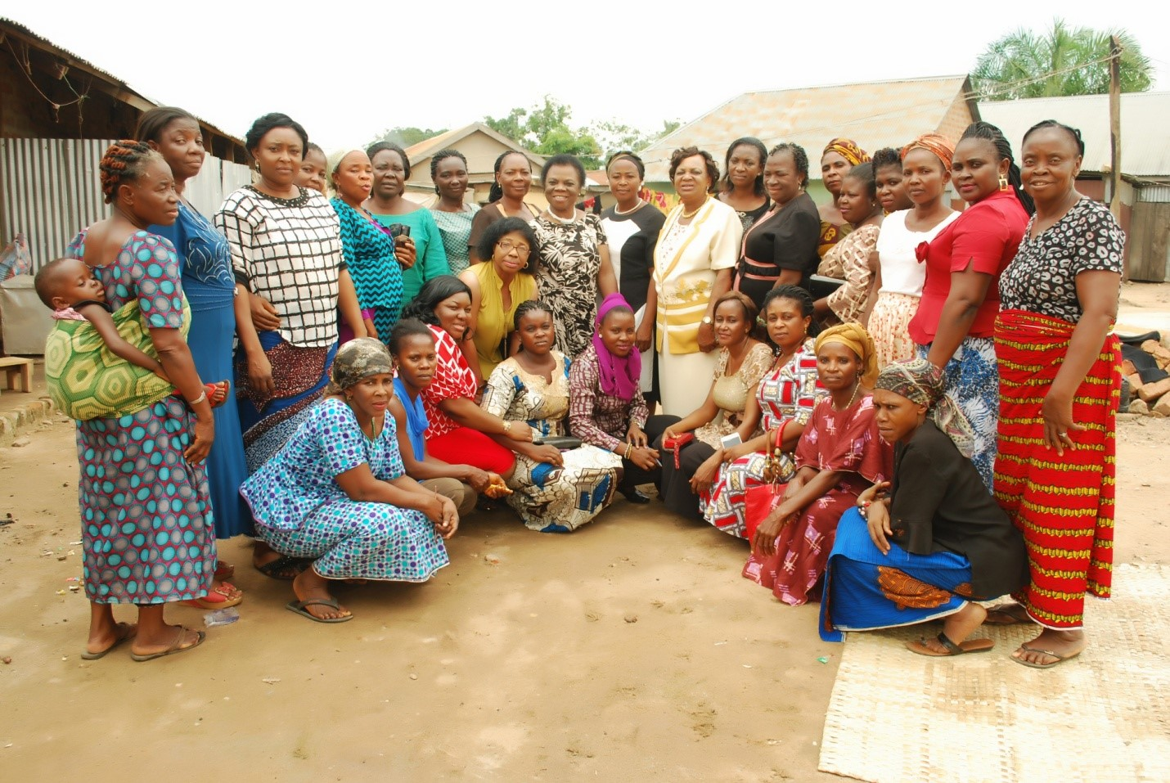
2016 Projects
Nigeria: Empowering Illiterate from Benue State Women of Nigeria (extension of existing project)
Notes:
Administered by: Association of University Women (NAUW)
Target Group: 50 illiterate women
AIM (two-fold): To improve and consolidate the financial positions of the target group to increase productivity and participation in community decision making.
Objectives
To ensure long lasting economic independence;
Outcome
Funding from GWI in 2011 and 2014 has increased literacy classes for the group, impacted modalities for obtaining soft loans and organised classes for basic leadership skills.

Slide 11
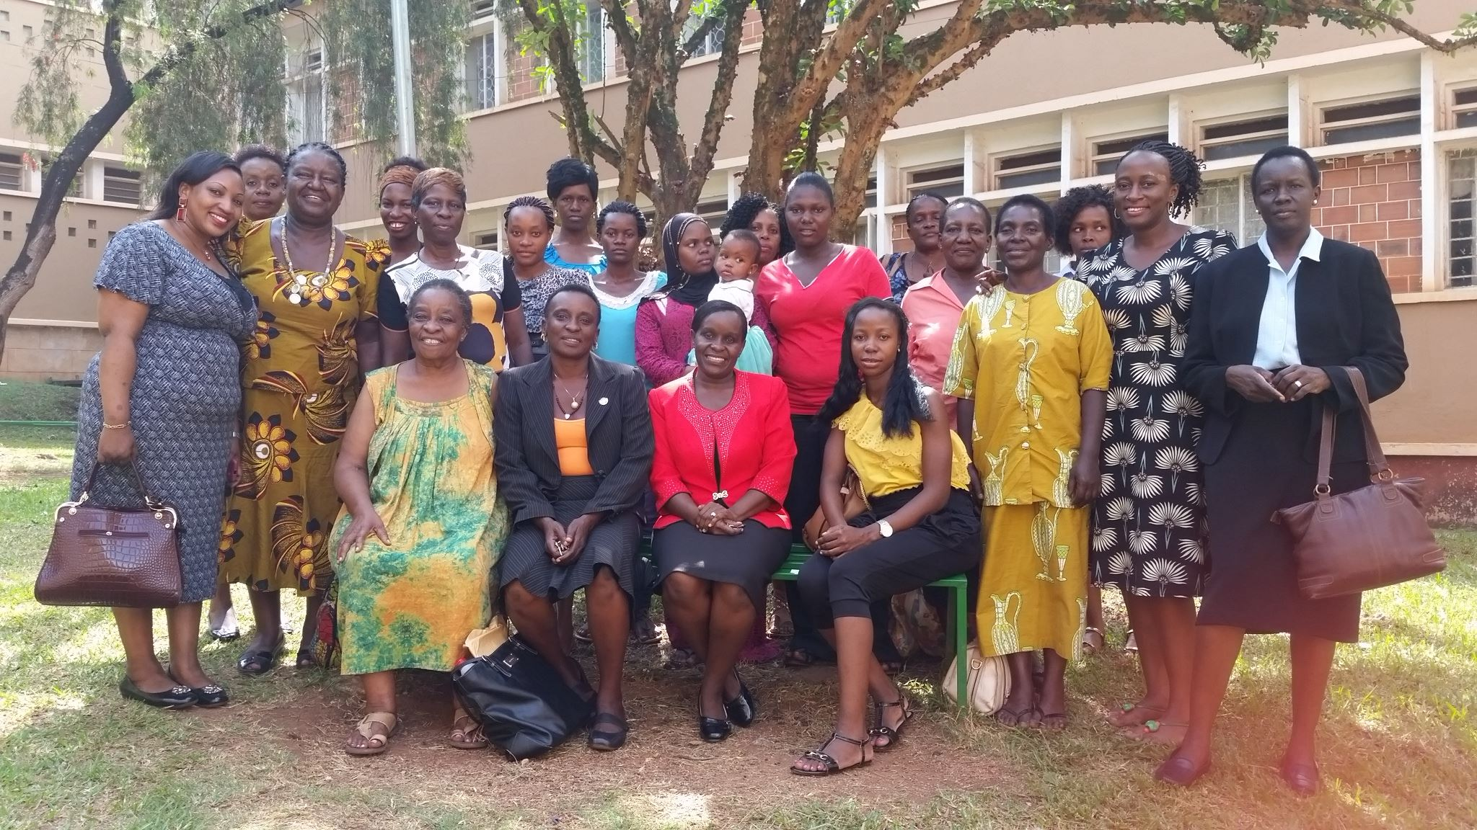
2016 projects
Uganda: Gender sensitisation of school laboratory technicians
Notes:
Administered by: Uganda Association of University Women (UAUW)
Target Group: Laboratory technicians from 20 Kampala district schools
Aim (three-fold): 1) To develop and use gender responsive methodologies that ensure equal participation of both girls and boys in laboratory activities 2) to boost girl’s interest in laboratory practical work and 3) to address the poor performance of girls in science-related projects.
Objectives
To organise gender sensitivity workshops for laboratory technicians;
To encourage girls’ participation and involvement during practical laboratory work;
To document the participants’ experiences and findings of the project;
To share findings with education stakeholders and other schools;
To enable the sensitization of a wider group of laboratory technicians at local and national level.

Slide 12
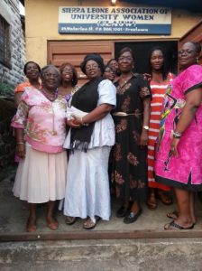
2016 projects
Sierra Leone: Community Initiative for Retention of Girls in School
Notes:
Administered by: Sierra Leone Association of University Women (SLAUW)
Target Group: Girls in secondary schools and tertiary levels
Aim: To promote the retention of girls in the target group and to support them to be achievement oriented through education by the end of 2017.
Objectives:
To empower the girls to become more assertive, confident and determined to pursue their educational career and to equip them to make meaningful contributions to community and national developments;
To attend educational camps with women achievers and share experiences in focus group discussions;
To involve their parents and community stakeholders in the process;
To include community meetings and visits - training on the rights to an education and have radio discussions on the barriers to girls’ education.

Slide 13
Distribution of BRPID
Notes:
Awards
2016 - 2017: 8 as described previously
2014 - 2015: 2 – Nigeria, Sierra Leone (SL)
2013 - 2014: 4 – Cambodia, SL, South Africa (SA), Uganda
2012 - 2013: 9 – Bangladesh, Cameroon, El Salvador, Fiji, Mexico, SL, SA, Thailand, Uganda
2011 - 2012: 8– Mexico, Maldova, Nigeria, Pakistan, Thailand, Turkey, Uganda, Kenya
Total in 5 year: 31

Slide 14
2017 Projects
2017 projects not posted yet
IN CONCLUSION
Limited information available on website – overview of projects only
No evaluation of projects reported: were they successful?
$ amount awarded unknown in total or for each project

